Slide 1
Homework 1
DSC 4310 • Luke Roe

Slide 2
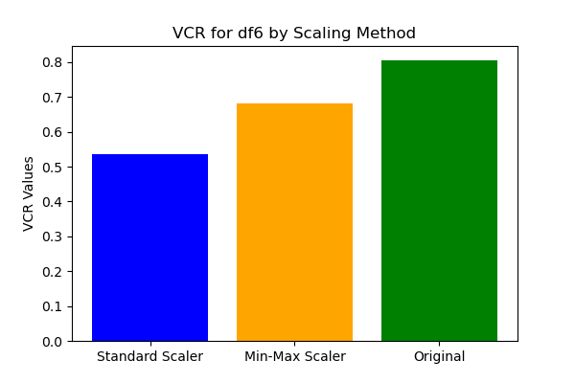
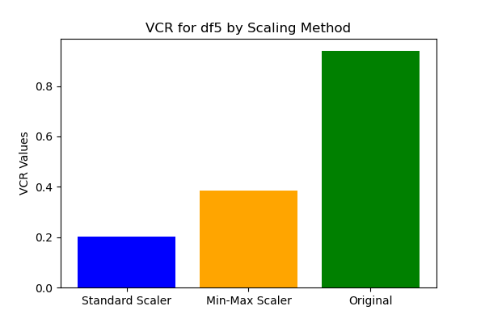
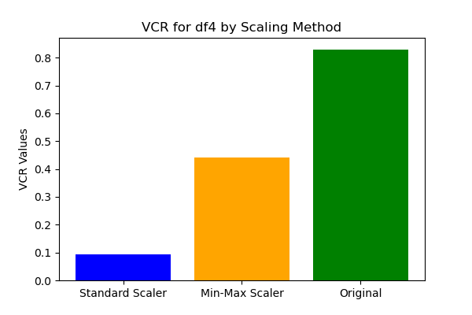
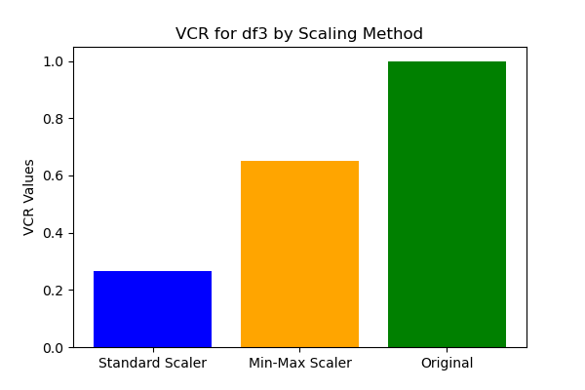
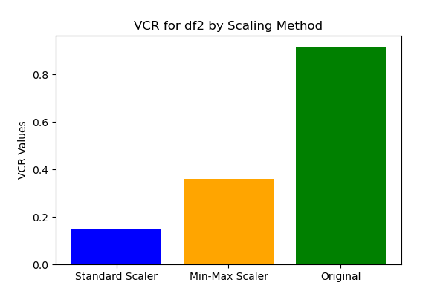
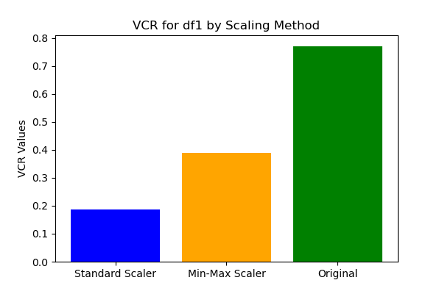
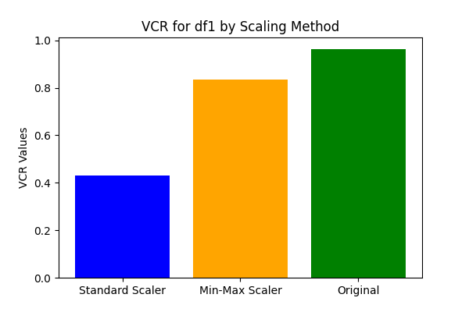
Breast Wisc Data
Shape: (569, 31)
SS VCR: 0.185965798821
MM VCR: 0.38940427266
Raw VCR: 0.77191593577

Slide 3
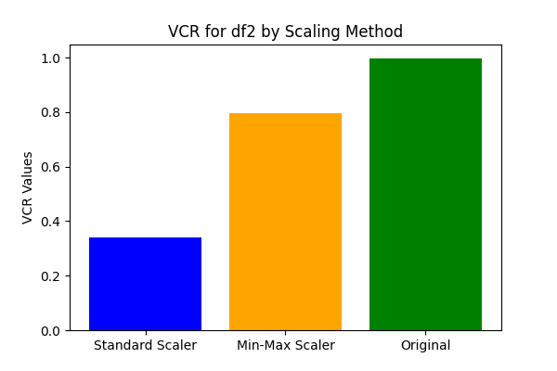
Cybersecurity Data
Shape: (510, 41)
SS VCR: 0.145950476097
MM VCR: 0.36090453378
Raw VCR: 0.9170993788

Slide 4
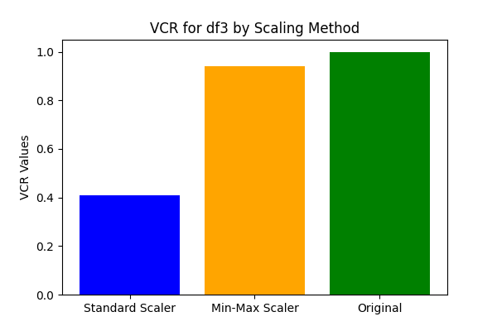
HFT AAPL Data
Shape: (5850, 10)
SS VCR: 0.26565792429
MM VCR: 0.65076893405
Raw VCR: 0.99974565598

Slide 5
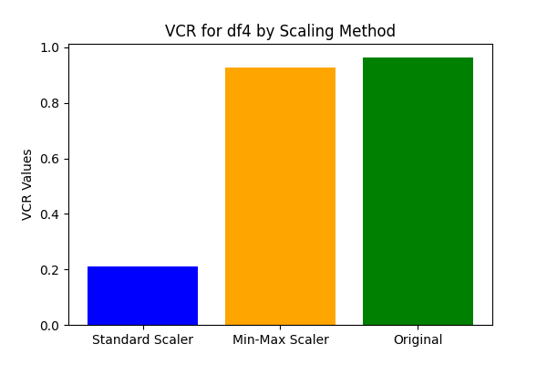
Music Data
Shape: (6705, 36)
SS VCR: 0.092761400643
MM VCR: 0.440286356707
Raw VCR: 0.82987793301

Slide 6
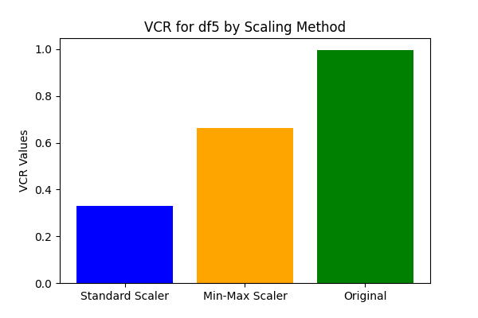
Option OTM Data
Shape: (8095, 11)
SS VCR: 0.20329003133
MM VCR: 0.38621005052
Raw VCR: 0.9407031069

Slide 7
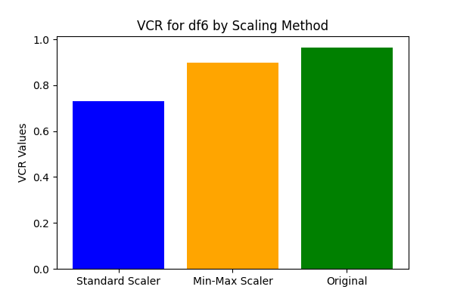
Iris Data
Shape: (150, 4)
SS VCR: 0.5352971788
MM VCR: 0.68002994149
Raw VCR: 0.80593406914

Slide 8
Summary
Dataset | (n,p) | SS VCR | MM VCR | Raw VCR
Breast Wisc | (569, 31) | 0.185965798821 | 0.38940427266 | 0.77191593577
Cybersecurity | (510, 41) | 0.145950476097 | 0.36090453378 | 0.9170993788
HFT AAPL | (5850, 10) | 0.26565792429 | 0.65076893405 | 0.99974565598
Music | (6705, 36) | 0.092761400643 | 0.440286356707 | 0.82987793301
Option OTM | (8095, 11) | 0.20329003133 | 0.38621005052 | 0.9407031069
Iris | (150, 4) | 0.5352971788 | 0.68002994149 | 0.80593406914

Slide 9
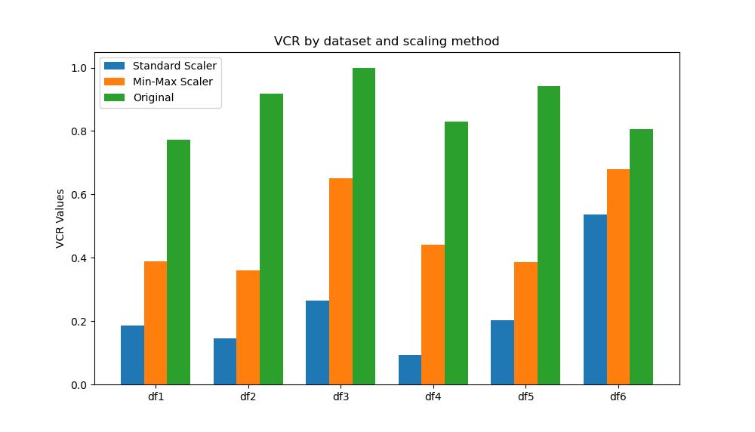

Slide 10
Conclusion
The datasets with higher dimensions tend to have lower VCR
The standard scaled data tends to have lower VCR than MinMax scalar or raw data
The music data (6705, 36) had the lowest VCR at 21.08%

